Slide 1

Presented By Omolara Buhari
Data Analytics EU –Class B-Cohort 25-04
ChatGPT Capstone Project using Tableau
FusionPoint Industries: Consumer Electronics Sales Trends and Profitability Analysis

Slide 2
OUTLINE
Introduction
Overview of Fusion Point Industries
Aim of the project
Approach - Analysis of the project
Dashboard
Key insights into each business question
Recommendations
Conclusion

Slide 3

Introduction
Introduction

Slide 4
Overview of FusionPoint Industries
.
Fusion Point Industries is a dynamic consumer electronics retailer serving customers across multiple U.S. states through a well-established omnichannel network. With a product portfolio that ranges from electronic games to office electronics, such as printers, Fusion Point aims to deliver high-quality, affordable, and innovative technology solutions.
By leveraging modern payment systems and efficient order fulfillment processes, the company strives to meet evolving consumer demands while maintaining profitability and market share. This project focuses on analyzing sales performance, profitability, and product trends to support data-driven decisions

Slide 5
Aim of the project
Analyze sales performance across products, sub-categories, and regions to identify high- and low-performing segments.
Measure profitability trends by product category, sub-category, and sales channel to support profit-driven decision-making.
Evaluate customer purchasing behavior and payment preferences to inform customer-centric strategies.
Identify patterns in demand over time and across geographies to optimize inventory and supply chain planning.
Provide actionable recommendations to enhance marketing, pricing, and product portfolio strategies for sustainable growth

Slide 6
Problem statement
Despite strong sales across diverse product categories, FusionPoint Industries faces challenges in understanding the drivers of profitability and regional sales performance within its consumer electronics division.
Inconsistent demand patterns, varying discount practices, and differences in payment modes make it difficult to identify which products, regions, and customer segments most contribute to sustained revenue growth.
Additionally, the business struggles to predict future sales with accuracy and to personalize customer offerings effectively. By leveraging artificial intelligence and advanced analytics, FusionPoint Industries can uncover actionable insights from its sales data, forecast demand, optimize pricing strategies, and drive targeted marketing initiatives to support data-driven, profitable growth

Slide 7
Visual Analysis of FusionPoint Industries (including Dashboards)

Slide 8
Data Analysis Approach
Data Collection & Preparation
Gather sales transaction data, clean and preprocess the data
Data Exploration & Descriptive Analytics
Use AI-assisted data exploration to identify patterns, outliers, relationships, and trends
Insight Visualization & Reporting using Tableau with AI features for smart recommendations and insights in a slide-deck
Summarize actionable findings, supported by AI-enhanced insights, to drive decisions on pricing, product assortment, and customer outreach

Slide 9
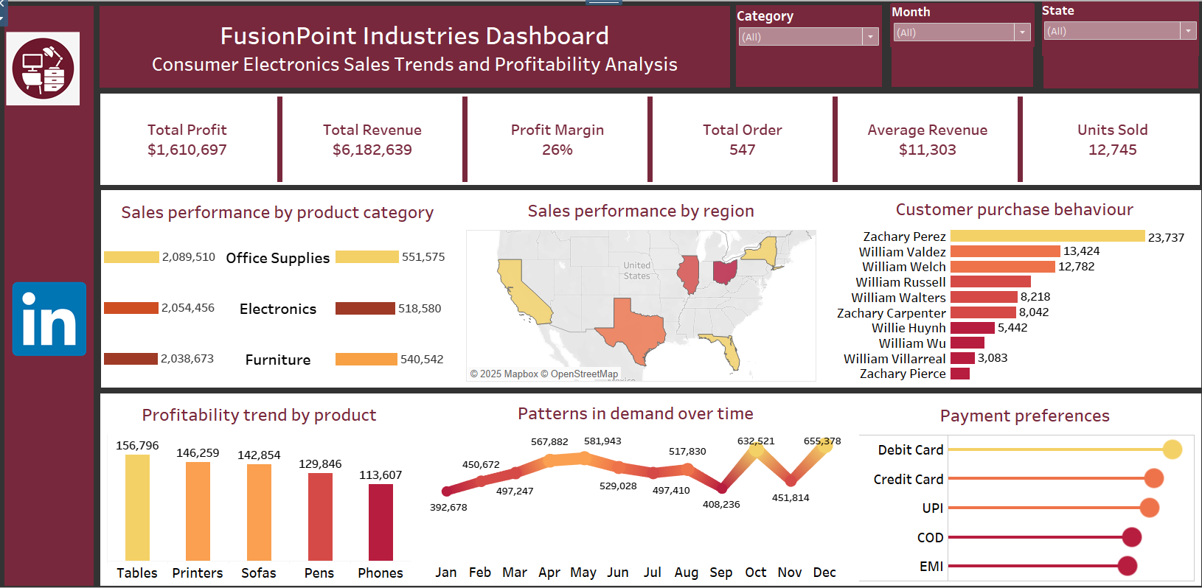

Slide 10

Key Insights
Overall Business Snapshot
Total Profit: $1,610,697
Total Revenue: $6,182,639
Profit Margin: 26%
Total Orders: 547
Average Revenue per Order: $11,303
Units Sold: 12,745
Insights
A strong 26% margin indicates healthy profitability.
Average revenue per order suggests mid- to high-ticket products contribute significantly.

Slide 11
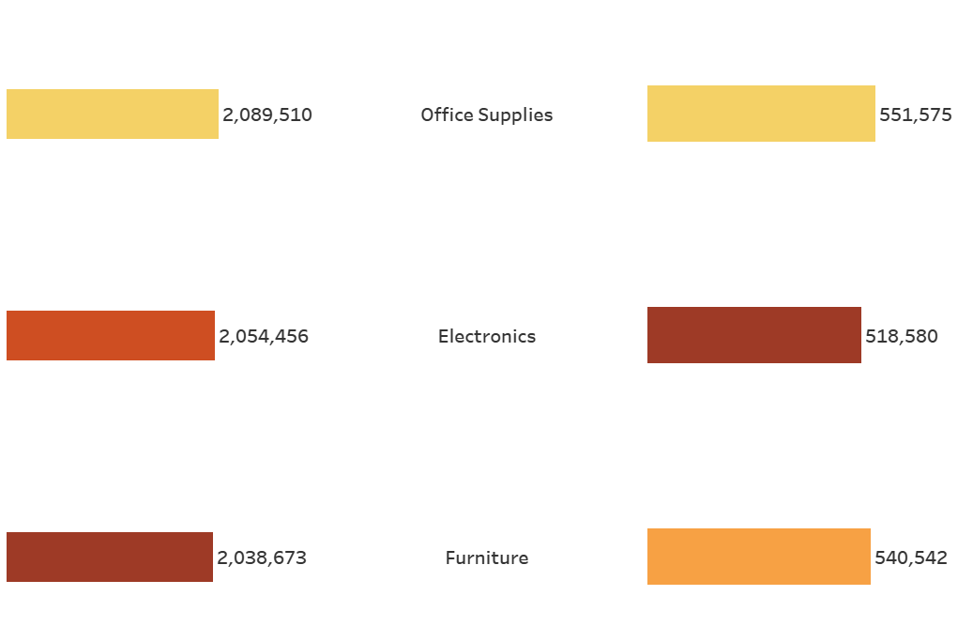
Sales performance by product category
All three categories generate nearly equal revenue, but Office Supplies edges slightly higher in revenue and profit.
Profit per dollar of revenue is strongest in Office Supplies (approx. 26%), making it the most efficient contributor.

Slide 12
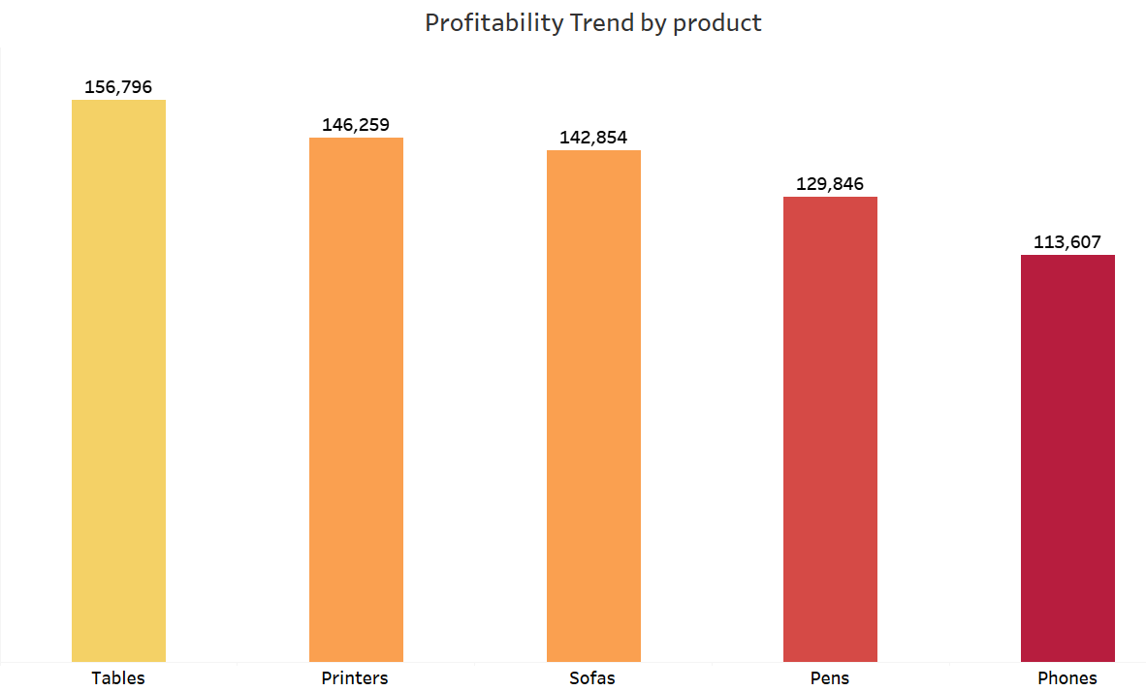
Tables and Printers deliver the highest profit contribution.
Phones, despite high sales volumes industry-wide, bring lower profit per unit.

Slide 13
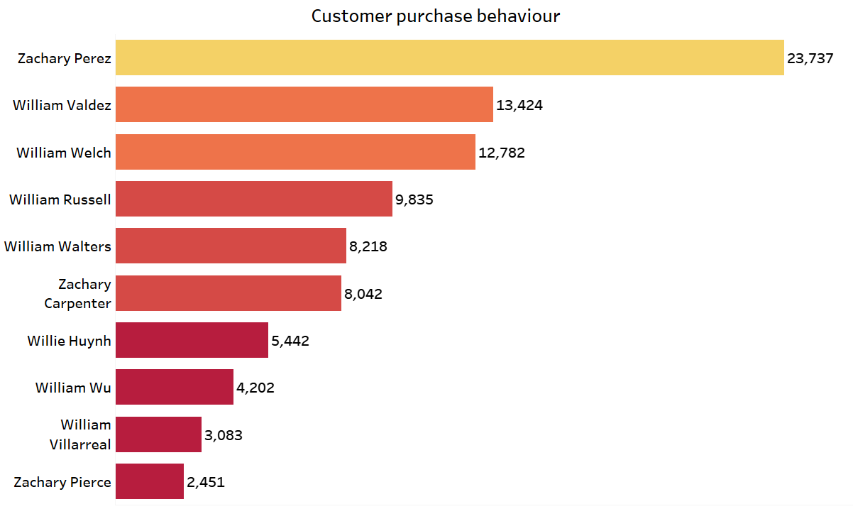
A small set of high-value repeat buyers (e.g., Zachary Perez $23.7 K) drives a disproportionate share of revenue.
Indicates potential for VIP-style loyalty and retention programs.
A small group of repeat customers drives a large share of revenue.
High-value customers show willingness for larger or frequent purchases
.

Slide 14
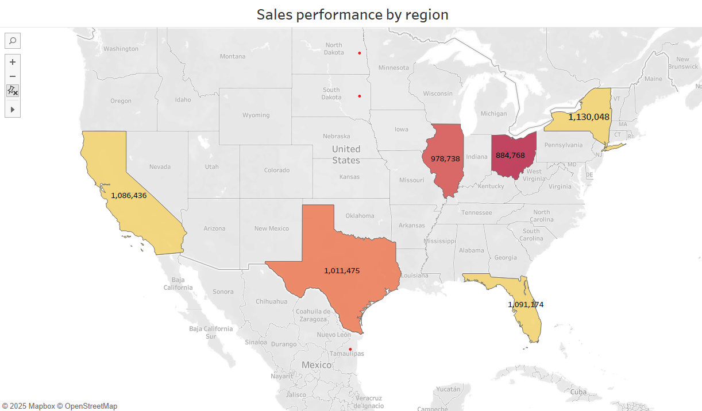
Sales performance by region
New York, Florida, and California are top revenue states.
Illinois and Ohio perform moderately, suggesting room for growth.
Texas is a strong southern hub.

Slide 15
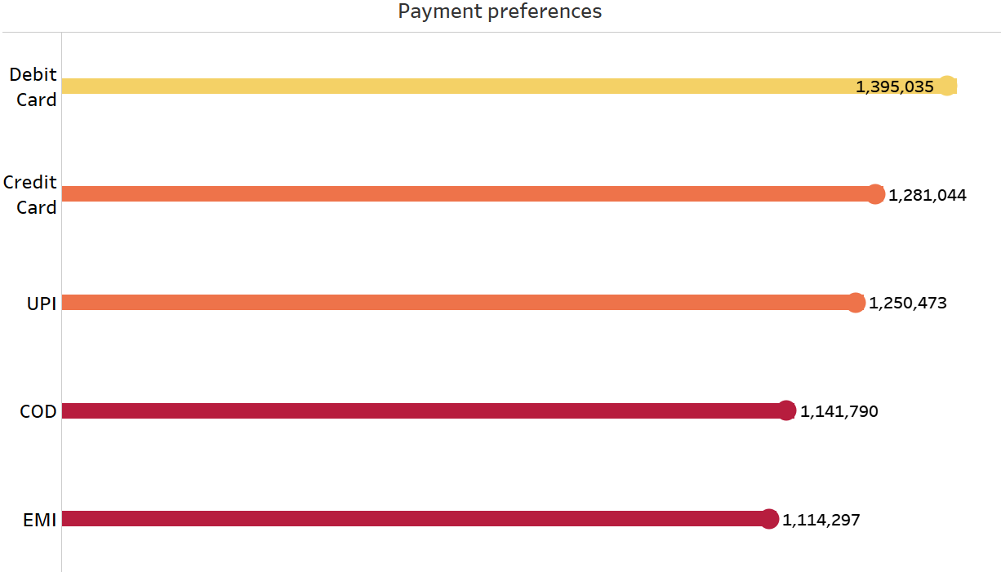
Digital payments (debit, credit, UPI) account for the majority of transactions.
Cash on Delivery and EMI remain significant, indicating a need for flexible options.

Slide 16
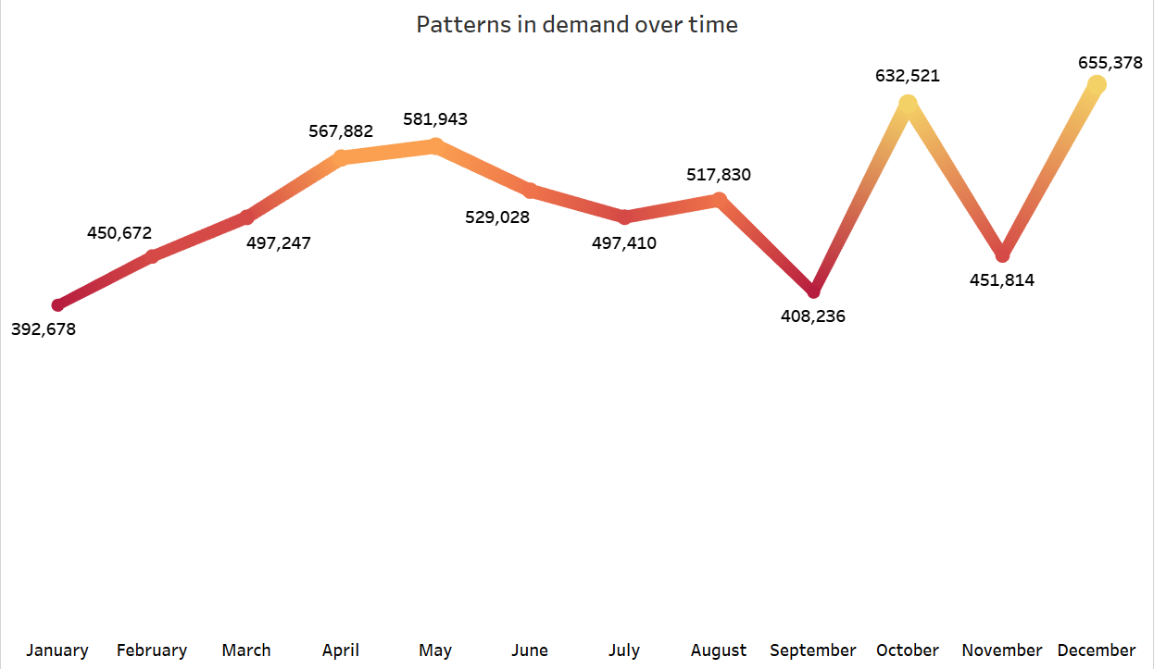
Clear seasonality: revenue peaks in September, November, and December (holidays, back-to-school, year-end).
Holiday sales cycles drive profitability.
Lowest demand in January–February, after holiday spending.

Slide 17
Recommendations
Pricing
Apply modest price increases on high-margin items (Office Supplies, Tables, Printers) to capitalize on strong demand.
Consider bundle pricing (e.g., phones with accessories) to raise low-margin product profitability.
Product Assortment
Expand high-profit categories (premium office supplies, furniture essentials).
Streamline or renegotiate supply costs for lower-margin electronics.
Customer Outreach
Launch VIP/loyalty programs for repeat buyers to increase lifetime value.
Prioritize marketing spend in New York, Florida, and California, while running growth campaigns in Illinois and Ohio.
Offer targeted seasonal promotions to smooth the January–February dip.
Operations & Payments
Encourage digital payments through small discounts or rewards to lower COD overhead.
Promote EMI plans to boost high-ticket electronics sales
Seasonality Planning – Build campaigns and stock for Q4 surges and create early-year promotions to smooth revenue dips

Slide 18
Conclusion
Fusion Point Industries is well-positioned for sustained growth, achieving $6.18 M in revenue with a 26 % profit margin and balanced category performance across Office Supplies, Electronics, and Furniture. Key revenue hubs—New York, Florida, California, and Texas—offer strong expansion potential, while Illinois and Ohio present growth opportunities. A loyal base of high-value customers, combined with the shift toward digital payments, creates leverage for profitable and low-cost customer engagement. Seasonal peaks in September, November, and December necessitate strategic inventory planning and early-year promotions to mitigate demand fluctuations.
Strategic Path Forward
Prioritize high-margin products (e.g., Tables, Printers) and adjust pricing for premium segments.
Expand loyalty and retention programs to maximize the lifetime value of top customers.
Target regional campaigns in high-performing and emerging states.
Optimize payment incentives to reduce COD costs and improve cash flow.
By executing these strategies, Fusion Point can amplify profitability, strengthen customer relationships, and secure long-term market leadership

Slide 19

Thank you
Presented By Omolara Buhari
Data Analytics EU –Class B-Cohort 25-04
ChatGPT Capstone Project using Tableau
FusionPoint Industries: Consumer Electronics Sales Trends and Profitability Analysis

